Slide 1

With the name of Allah, Who is the most Gracious and Merciful

Slide 2
Omega Notation (Ω):
In asymptotic notation, particularly Big Omega (Ω), we express the lower bound of an algorithm's running time. It provides a way to describe the best-case scenario for the growth rate of a function.
For a function g(n), we say that g(n) is Ω(f(n)) if there exist positive constants c and n₀ such that for all n greater than or equal to n₀, the function g(n) is greater than or equal to c * f(n).
.

Slide 3

Big-Omega Notation (Ω)
we can define Big-Omega as
.
We may write f(n) = Ω(g(n)) OR f(n) ∈ Ω(g(n))
Set of all functions whose rate of growth is the same as or higher than that of g(n).

Slide 4
Big Omega notation Just Like O notation provides an asymptotic upper. bound, notation provides asymptotic lower bound:
Let f(n) define the running time of an algorithm on is said to be (g(n) if there exists position Constants C and no such that
○ < (g(n) < = f(n) for all n >= no
used to give a lower bound on a function
“n” is a variable representing the input size or some parameter in an algorithm.
“no” is a constant (threshold or starting point) indicating the minimum value for n from which the inequality is satisfied.

Slide 5
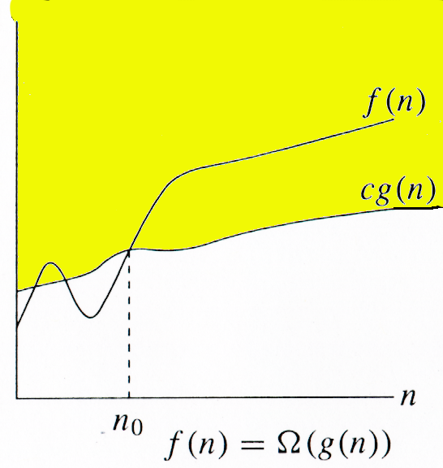
Big-Omega Notation
f(n) ∈ Ω(g(n))
g(n) is an asymptotically lower bound for f(n).
Advanced Algorithms Analysis and Design

Slide 6
Examples
Examples
Example 1: Prove that 5.n² ∈ Ω(n)
Proof:
Assume that f(n) = 5.n² , and g(n) = n
f(n) ∈ Ω(g(n)) ?
We have to find the existence of c and n₀ s.t.
c.g(n) ≤ f(n)  n ≥ n₀
c.n ≤ 5.n²  c ≤ 5.n
if we take, c = 5 and n₀= 1 then
c.n ≤ 5.n²  n ≥ n₀
And hence f(n) ∈ Ω(g(n)), for c = 5 and n₀= 1
Advanced Algorithms Analysis and Design

Slide 7
Examples
Examples
Example 2: Prove that 5.n + 10 ∈ Ω(n)
Proof:
Assume that f(n) = 5.n + 10, and g(n) = n
f(n) ∈ Ω(g(n)) ?
We have to find the existence of c and n₀ s.t.
c.g(n) ≤ f(n)  n ≥ n₀
c.n ≤ 5.n + 10  c.n ≤ 5.n + 10.n
if we take, c = 15 and n₀= 1 then
c.n ≤ 5.n + 10  n ≥ n₀
And hence f(n) ∈ Ω(g(n)), for c = 15 and n₀= 1
Wajahat Akbar Advanced Algorithms Analysis and Design

Slide 8
Thank You

